Slide 1
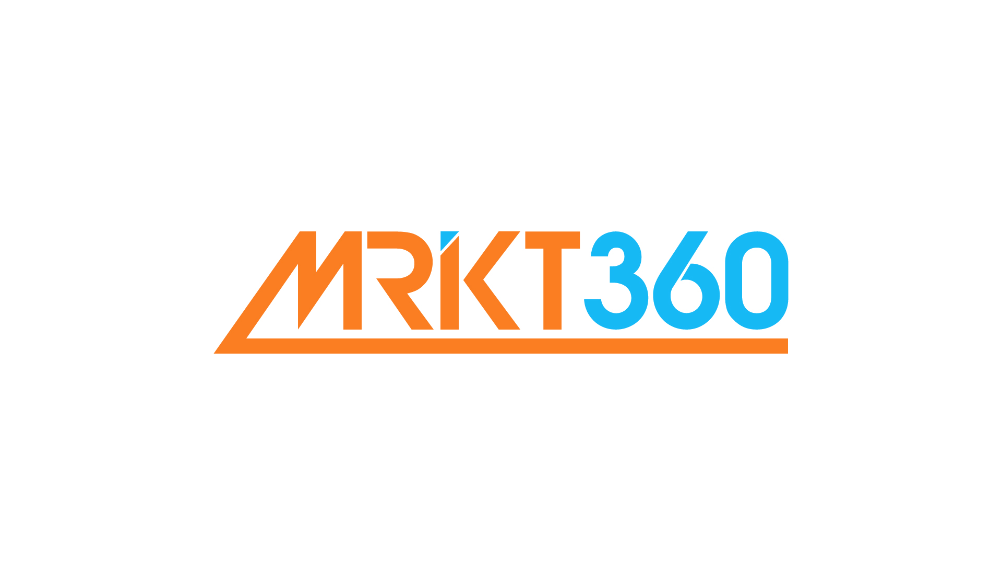
Add a + to make your marketing on Google social.

Slide 2
What is Google+?It’s a way of making your Google experience social.
Launched by Google in June 2011.
It has 400 million* registered users.
Users add friends to their ‘circles’ to share content and to video chat.
The top branded pages on Google+ have several million followers.
What?
Why?
Getting started
Link
Measure
Conclusion
*Source: Google Internal Data. Last updated: September 2012.

Slide 3
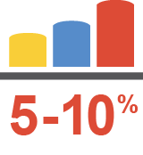
What can Google+ do for you?See an average increase of 5-10%* in search and click-through rates with Google+.
What?
Why?
Getting started
Link
Measure
Conclusion
*Source: Google Internal Data. Last updated: July 2012.

Slide 4
Why use Google+?Boost online marketing performance.
Get closer to potential customers when they're online and engaged.
Increase awareness with Google+ recommendations. Customers’ can see and interact with the brands and companies that they're following on Google+.
Build trust – potential customers look favorably on brands if they see that people in their circles are following them or have +1'd their profiles.
What?
Why?
Getting started
Link
Measure
Conclusion

Slide 5
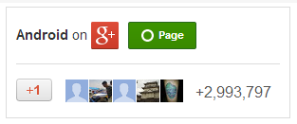
Getting started with Google+ is easy.Get started in only 3 steps.
Create a Google+ page and get it verified. It will be the center of your brand’s identity on Google.
Add the Google+ badge to your company website to
help grow your Google+ followers.
Link your Google+ page to your ads.
What?
Why?
Getting started
Link
Measure
Conclusion

Slide 6
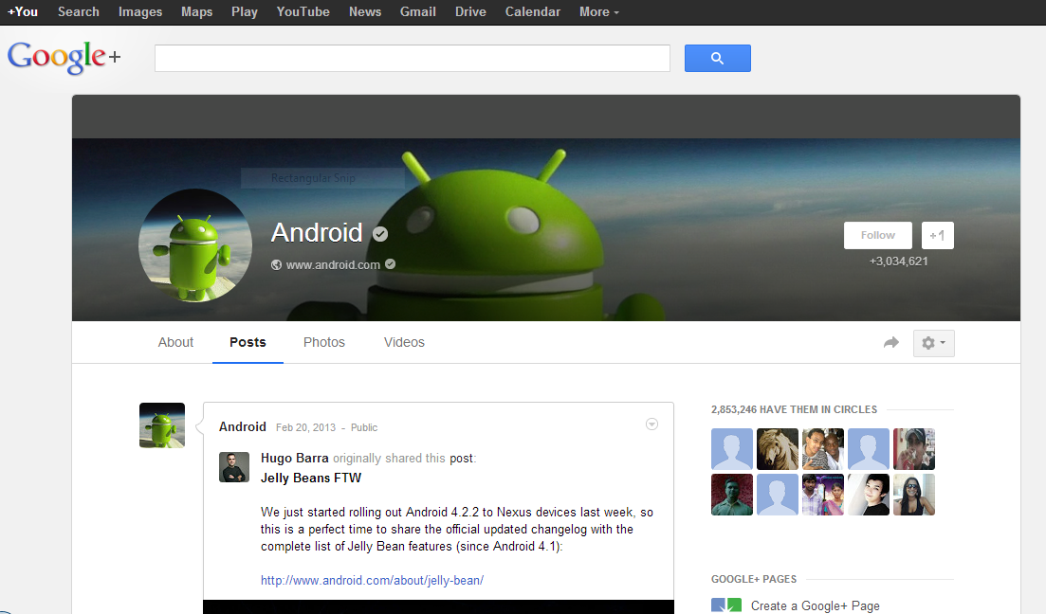
This is how your page could look.
What?
Why?
Getting started
Link
Measure
Conclusion

Slide 7
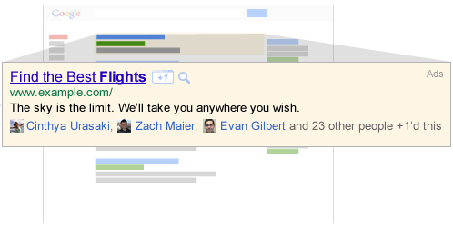
Link your Google+ page to your ads.Expand your brand presence online.
Get more recommendations, follows, clicks and potential customers by linking your page and your ads.
Linking your Google+ page to your ads combines the +1’s on Google+ pages with your campaigns.
This can help increase an ad’s click-through rate by 5-10%*.
What?
Why?
Getting started
Link
Measure
Conclusion
*Source: Google Internal Data. Last updated: July 2012.

Slide 8
Measuring the impact of Google+.Using AdWords.
By using the +1 Annotations section in Google AdWords Reporting, it is easy to see full statistics including clicks, impressions and click-through rates for campaigns linked to your brand’s Google+ page.
What?
Why?
Getting started
Link
Measure
Conclusion

Slide 9
And finally...Google+ is a brilliant way to boost the performance of online marketing:
It helps increase the number of people seeing your ads.
Potential customers online will trust you more.
Your brand is more personal, social and engaging.
It’s easy to get started and expand your brand presence online.
What?
Why?
Getting started
Link
Measure
Conclusion

Slide 10
Thank you.
If you have any queries or would like help setting up Google+ please contact:
www.mrkt360.com

