Slide 1
THE
MRKT360 WAY
How we work with our customers to achieve maximum productivity, and real results !

Slide 2
INITIAL MEETING
The purpose of this meeting is not only to get to know one another, but get straight to business. We want to know exactly what your short and long terms goals are and how we can get about to achieving them.

Slide 3
Company Questions
Who are your customers?
Who are your competitors?
What is your ‘secret sauce’/ unique selling point?
What is your company mission?
How do you fit into your industry?
What is your average sale price?
What are your company revenue targets?
What is your elevator pitch? If we met at a cocktail party, how would you describe what your company does in 30 seconds?

Slide 4
ZZZZZZ
Marketing Questions
Why do you want to change your approach to marketing now?
What are your expectations for a marketing program?
What specific marketing have you tried in the past? What worked? What didn’t?
How many people do you have in the Marketing department?
What marketing activities are you engaged in now?
Which ones are most successful? Which ones didn’t work?
How do you track the results of your marketing?
Profile the perfect client for your company?
What are you trying to achieve with the web site?

Slide 5
What is your top priority this year?
Do you have specific company goals?
What are your top 3 initiatives this year/quarter?
Do you have published revenue goals for this upcoming quarter/year?
Are there any other company goals that are important?
Do you have personal goals that go along with these?
When do you need to achieve these results?
What is the most critical date on your calendar and why?
What is the time line to achieve your goals?
Is hitting this goal a priority right now?
Goals and Timeline
Questions

Slide 6
Potential Challenges
Questions
What obstacles do you think will keep your plan from working?
What’s going to get in the way of hitting your goal?
What do you think is your biggest marketing challenge?
Why do you think you’ll be able to eliminate these challenges now, even though you’ve tried in the past and you’re still dealing with them?
Do you think you have the internal expertise to deal with these challenges?
How are you addressing these challenges in your plan?

Slide 7
Where do we communicate with our clients?

Slide 8
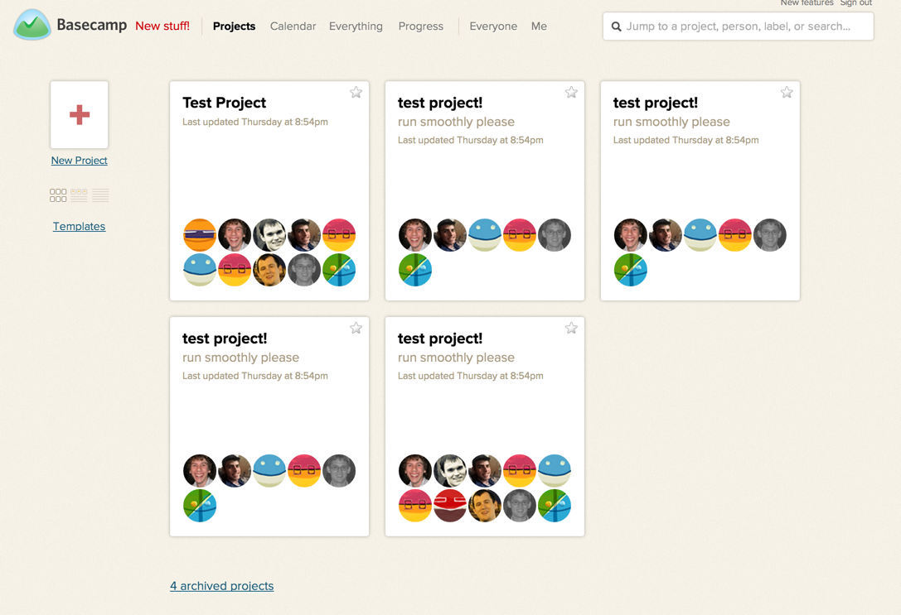

Slide 9
What can we do for our clients?

Slide 10
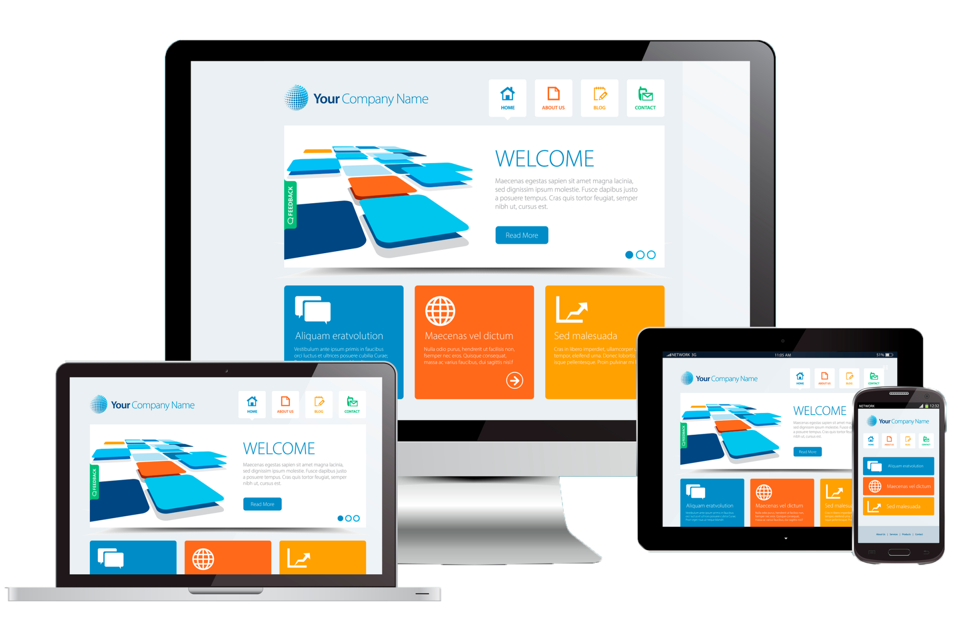
Create and design a converting website

Slide 11
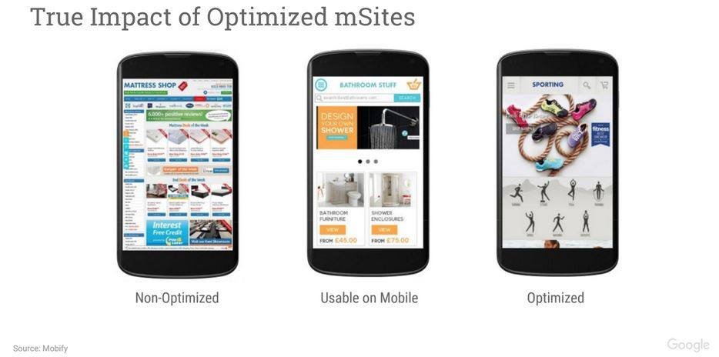
Ensure your website is mobile friendly

Slide 12
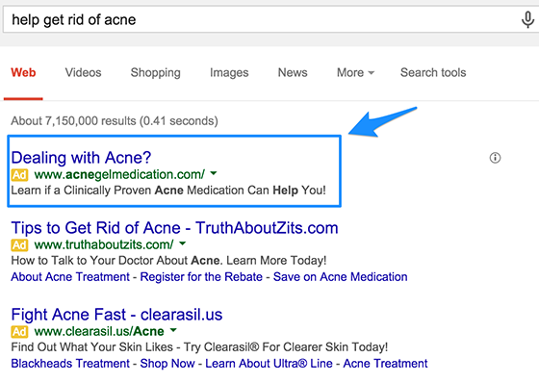
Help you Advertise on Google

Slide 13
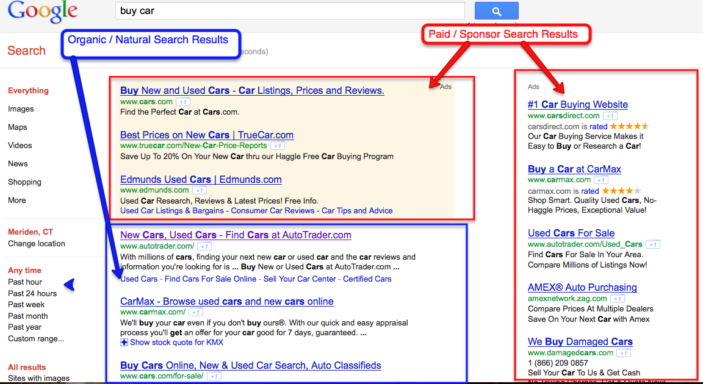
Ensure you show up on organic search results

Slide 14
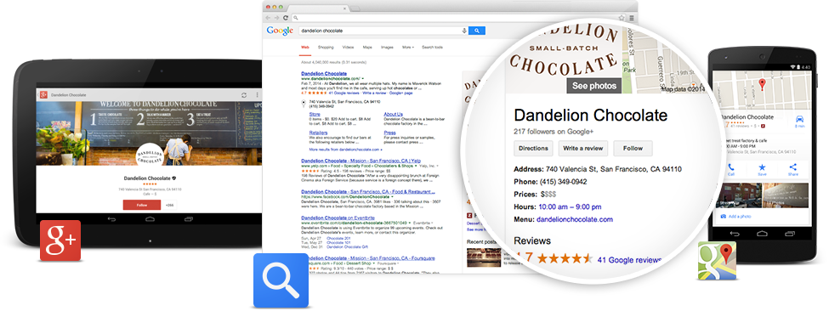
Get you on Google My Business

Slide 15
Create a presence for you on social media

Slide 16
How do
we
measure
success?
AND MORE!

Slide 17
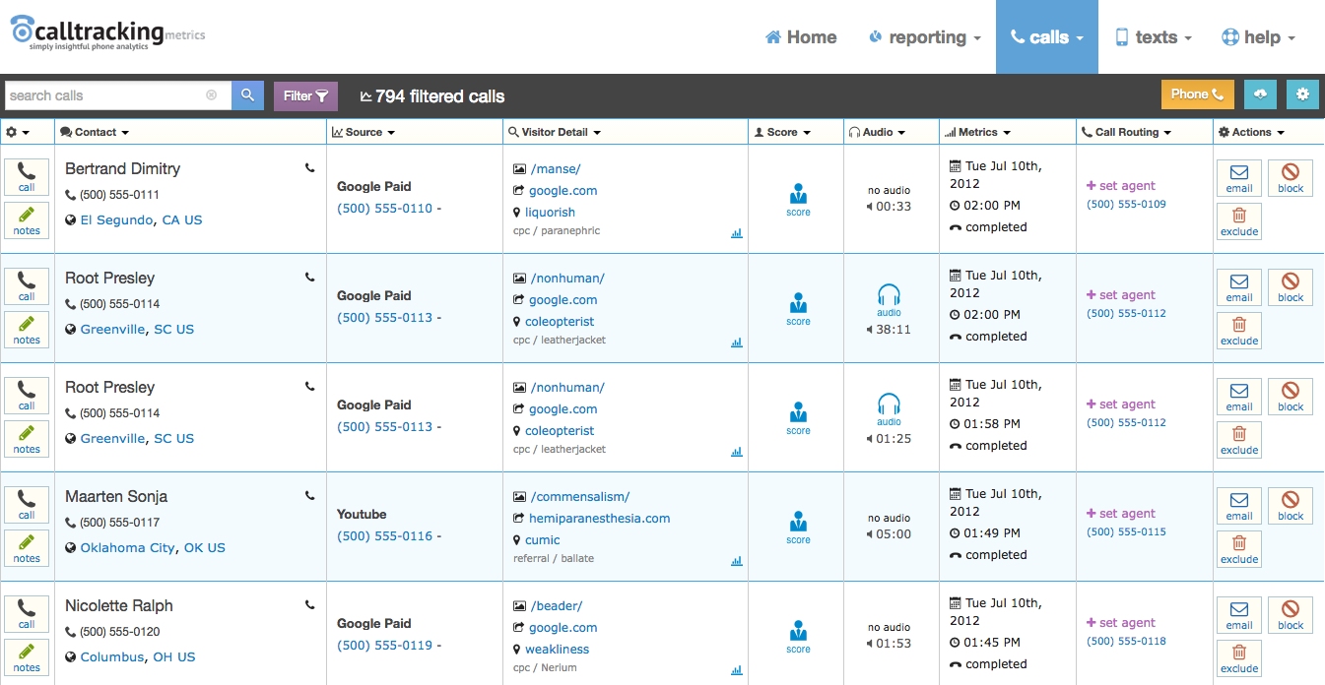

Slide 18
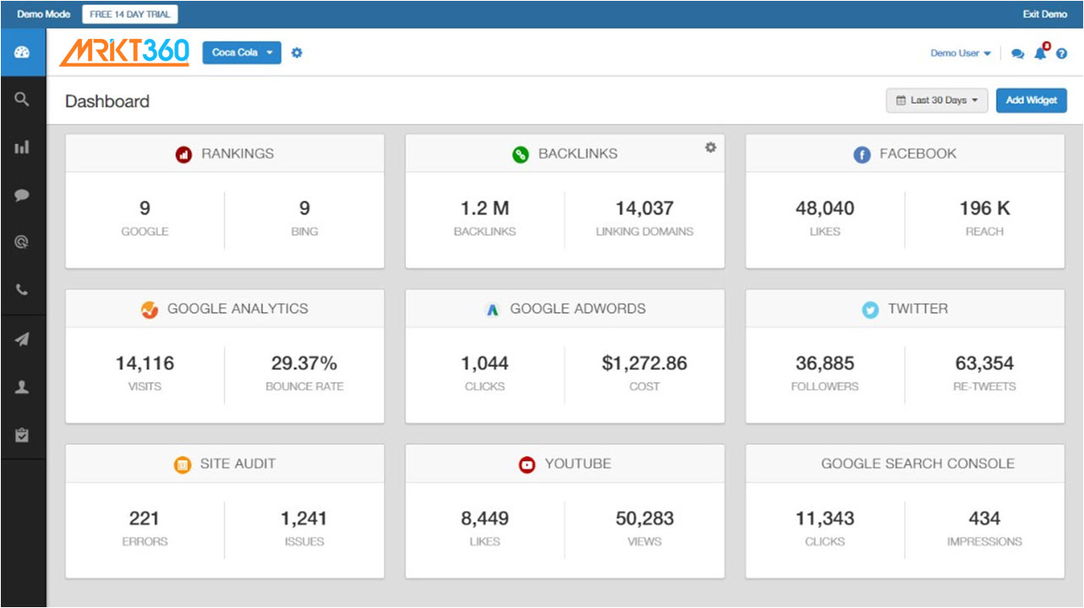

Slide 19
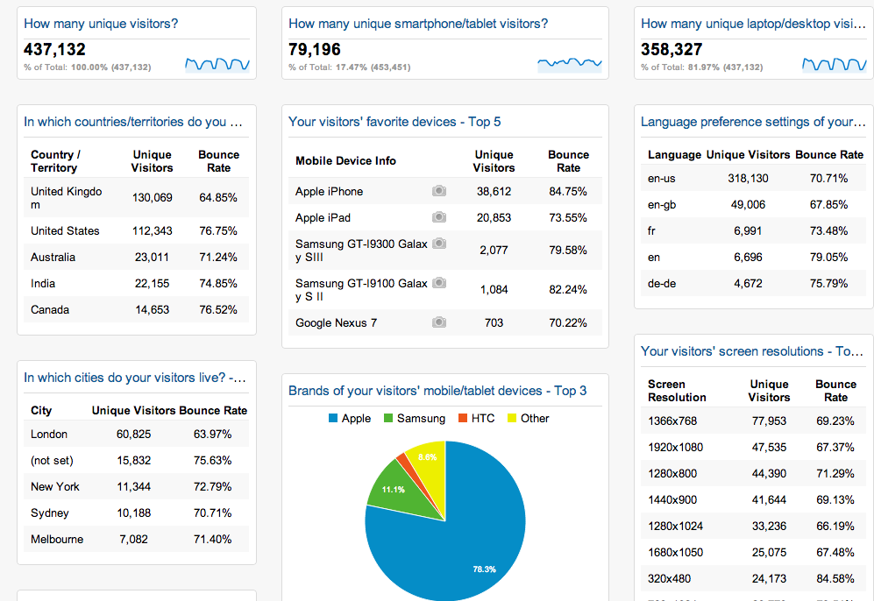

Slide 20
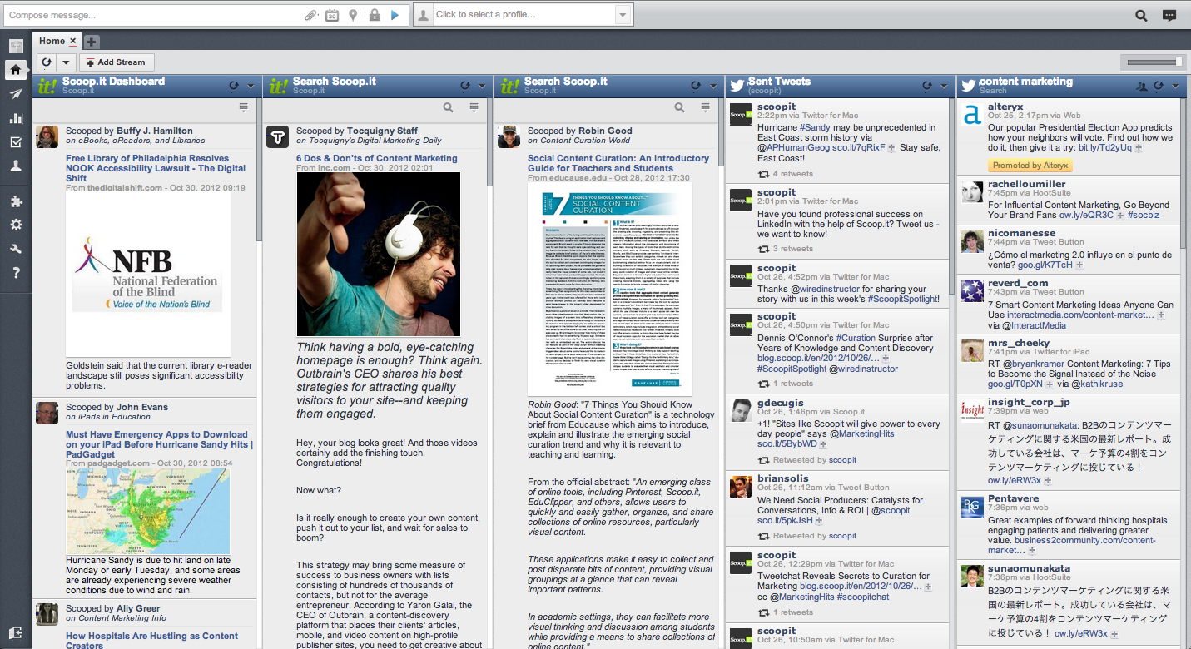

Slide 21
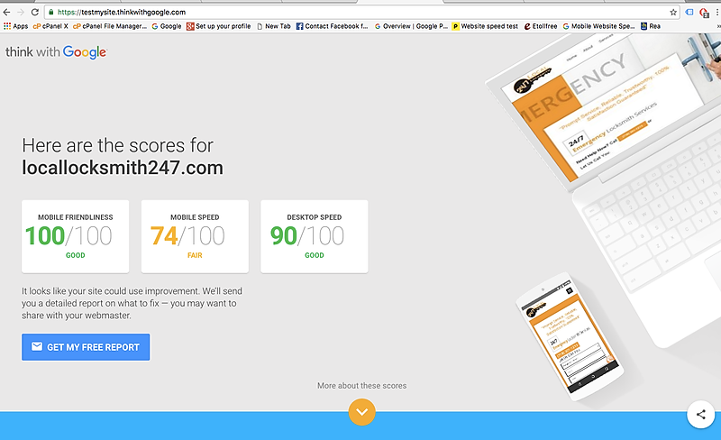

Slide 22
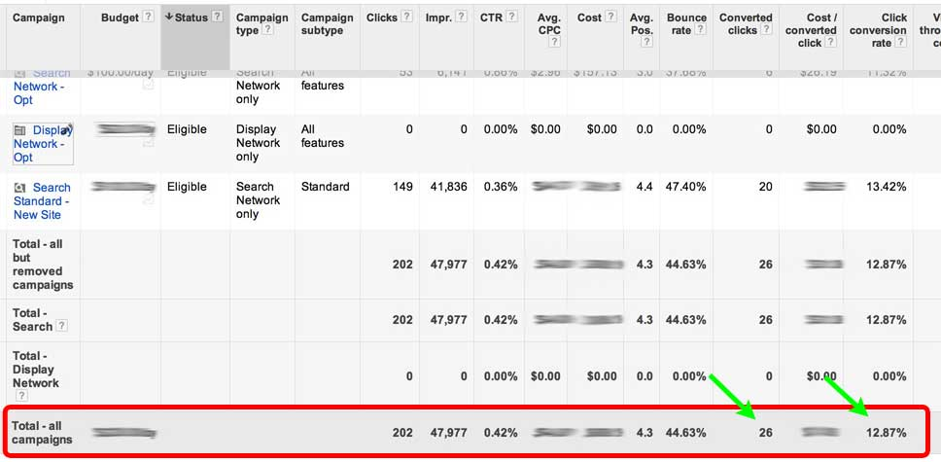

Slide 23
WE …
Create tailored solutions based on your industry, company, and marketing goals
Help you gain deeper insights about your target market
Use advanced tools to ensure your strategy performs at 100% capacity
Identify opportunities for further growth
Maximize your spend and improve efficiency through continual refinement of campaigns

